Slide 1
Angular
Author: Giau Le

Slide 2
References
Roadmap
https://roadmap.sh/frontend
Prerequisite
https://www.w3schools.com/css/
https://www.w3schools.com/html/
https://www.typescriptlang.org/docs/handbook/typescript-in-5-minutes.html
Angular Docs
https://angular.dev
SCSS
https://sass-lang.com/guide/
UI Libs
https://getbootstrap.com/ or https://tailwindcss.com/docs/guides/angular
https://material.angular.io/ -> angular components
RxJs
https://rxjs.dev/
Project demo
https://github.com/helenhash/angular-demo

Slide 3
Agenda
Angular Introduction
Server side rendering vs Client side rendering
Overview
Angular Webapp Flow Example
Set up Environment
Explore Angular project
Component
TypeScript
Angular Data Binding

Slide 4
Angular Introduction
A application design framework and development platform creating efficient and sophisticated single-page apps.
Combines declarative templates, dependency injection, end to end tooling, and integrated best practices to solve development challenges.
“A single-page application (SPA) is a web application or website that interacts with the web browser by dynamically rewriting the current web page with new data from the web server, instead of the default method of the browser loading entire new pages.”

Slide 5
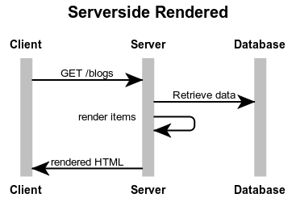
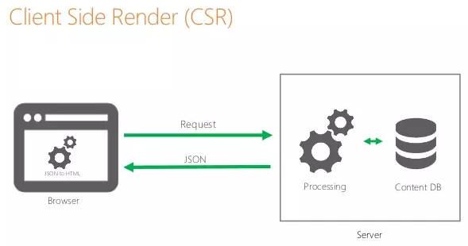
Angular Introduction

Slide 6
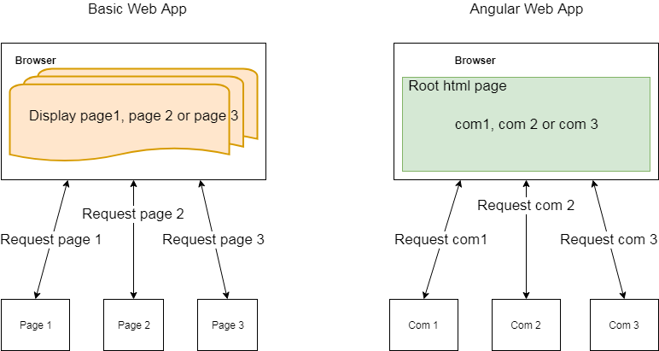
Angular Introduction

Slide 7
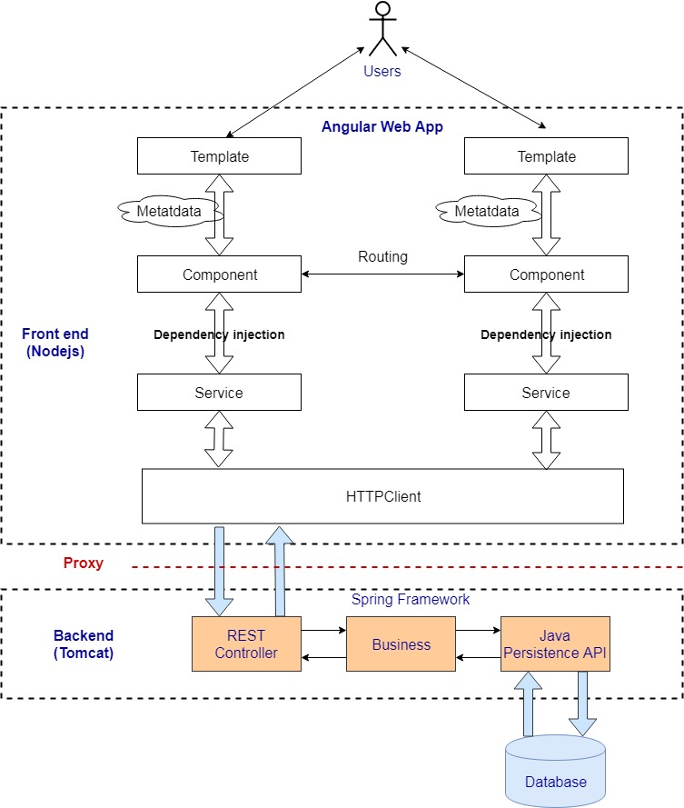
Angular Webapp Flow Example

Slide 8
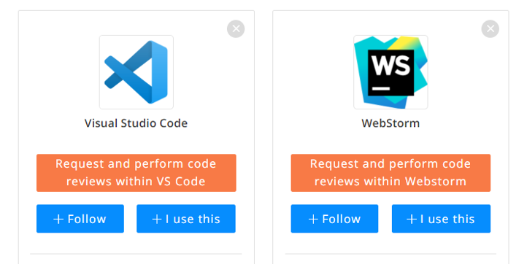
Set up Environment
IDE

Slide 9
Set up Environment
Docs
https://code.visualstudio.com/
https://code.visualstudio.com/docs/nodejs/angular-tutorial
Extention
Angular Language Service, EditorConfig for VS Code, ESLint/TSLint, Nx Console (optional)

Slide 10
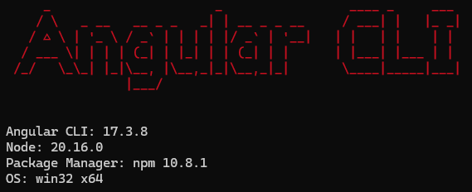
Set up Environment
Install
Node.js npm
https://nodejs.org/en/download/
Angular CLI
npm install -g @angular/cli@17
You can check the version:
node –v or npm –v, ng v
More details: https://angular.dev/installation
Intro to Yarn (optional)
https://yarnpkg.com/
Yarn is generally faster than NPM
pnpm (optional)
https://pnpm.io/

Slide 11
Explore Angular project
Open cmd and point to folder
ng new my-app --ssr=false
ng new my-app --no-standalone --routing --ssr=false
Go to the project directory and launch the server.
cd my-app (go to folder project)
ng serve –open
OR ng serve --port=other-port. Ex: ng serve --port=9000
The ng serve command launches the server, watches your files, and rebuilds the app as you make changes to those files.
Open your browser on http://localhost:4200/
Agular CLI command
https://angular.dev/cli

Slide 12
Explore Angular project
Project file structure
https://angular.dev/reference/configs/file-structure
Behind the scense
https://medium.com/siam-vit/how-an-angular-app-work-behind-the-scenes-angular-flow-dcc4d1df27bd

Slide 13
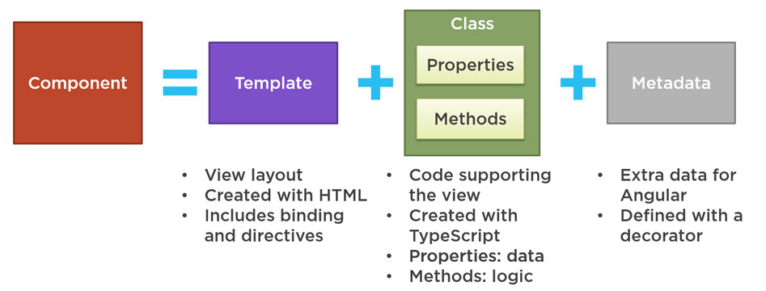
Component

Slide 14
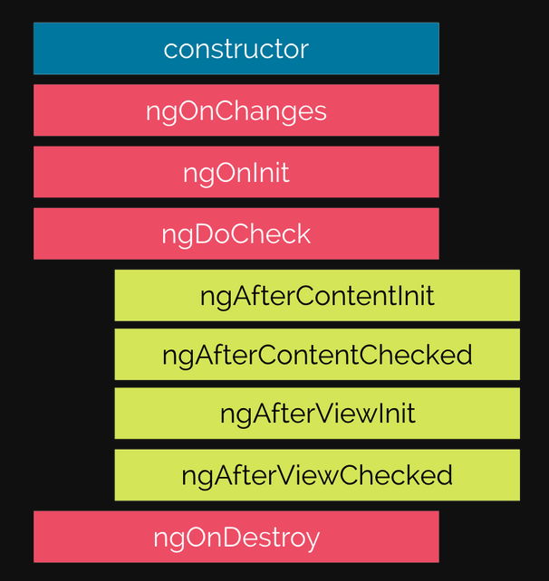
Component lifecycle

Slide 15
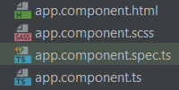
Component
https://angular.dev/guide/components
Angular CLI: ng generate component hero
Angular components form the data structure of your application.
The HTML template associated with a component provides the means to display that data in the context of a web page.

Slide 16
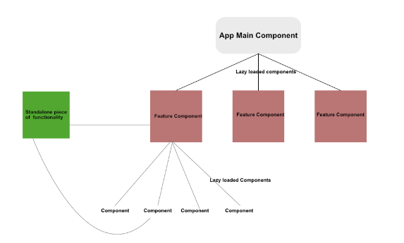
Module -> Standalone

Slide 17
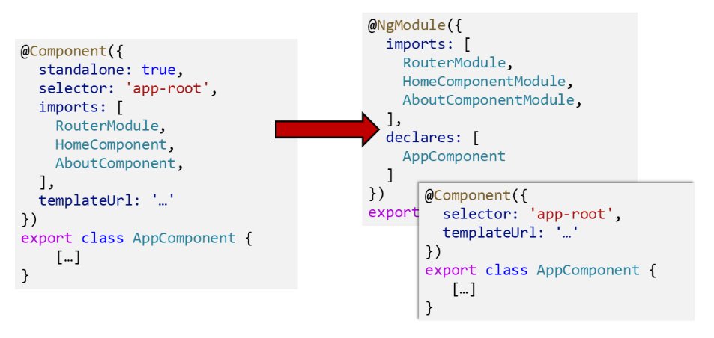
Module
https://angular.dev/guide/ngmodules

Slide 18
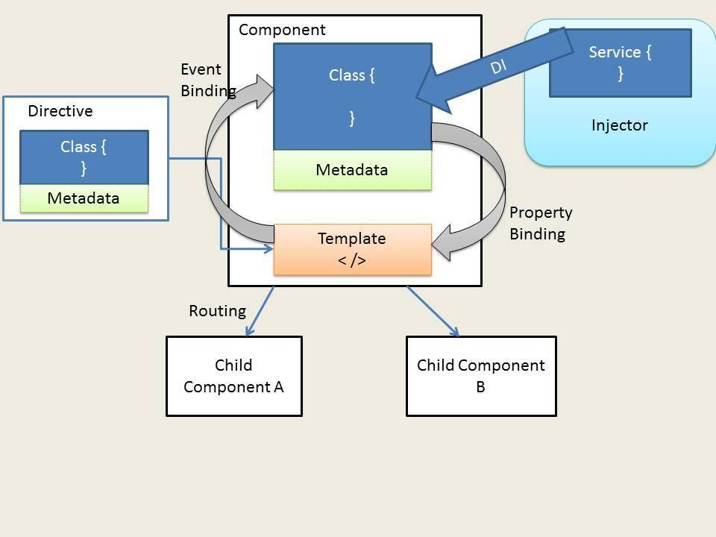
Explore Angular project

Slide 19
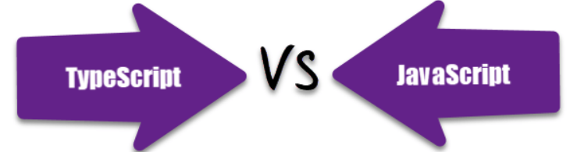
TypeScript
JavaScript is a scripting language which helps you create interactive web pages whereas Typescript is a superset of JavaScript.
TypeScript being a superset of JavaScript
Typescript code needs to be compiled while JavaScript code doesn’t need to compile.
Typescript supports a feature of prototyping while JavaScript doesn't support this feature.
Typescript uses concepts like types and interfaces to describe data being used whereas JavaScript has no such concept.
Typescript is a powerful type system, including generics & JS features for large size project whereas JavaScript is an ideal option for small size project.

Slide 20
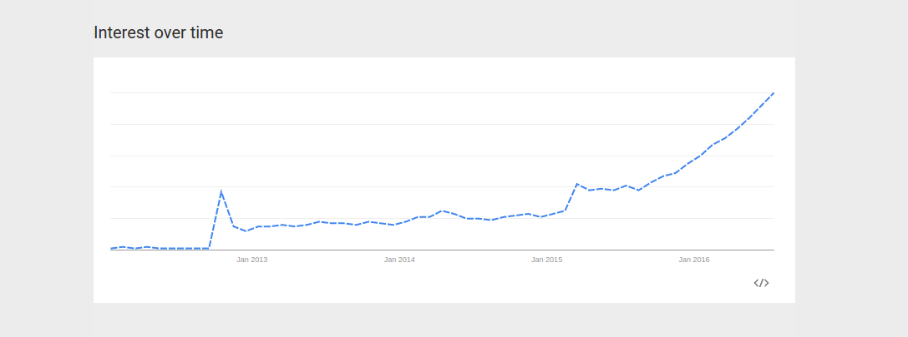
TypeScript

Slide 21
TypeScript
https://www.typescriptlang.org/docs/handbook/typescript-in-5-minutes.html

Slide 22
TypeScript
Variable Declarations
let and const are two relatively new types of variable declarations in JavaScript.
let color: string = "blue";
let list: number[] = [1, 2, 3];
const numLivesForCat = 9;

Slide 23
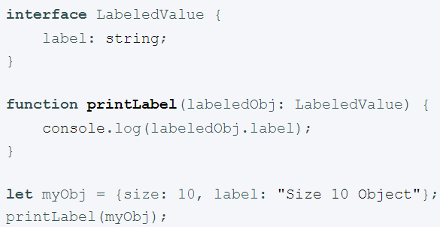
TypeScript
Interface
Interfaces fill the role of naming these types, and are a powerful way of defining contracts within your code as well as contracts with code outside of your project.

Slide 24
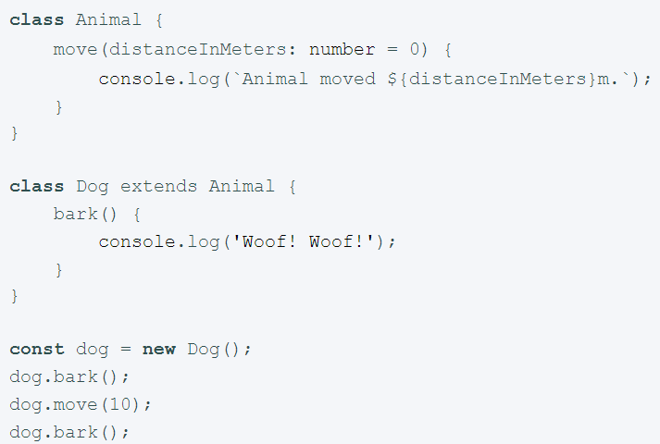
TypeScript
Class
The syntax should look familiar if you’ve used C# or Java before.
we can use common object-oriented patterns. One of the most fundamental patterns in class-based programming is being able to extend existing classes to create new ones using inheritance.
Public by default

Slide 25
Angular Data Binding
Data-binding is a mechanism for coordinating what users see, specifically with application data values.
Source-to-view
View-to-source
View-to-source-to-view
Interpolation ( {﻿{...}} ):
<p>My current hero is {{currentHero.name}}</p>

Slide 26
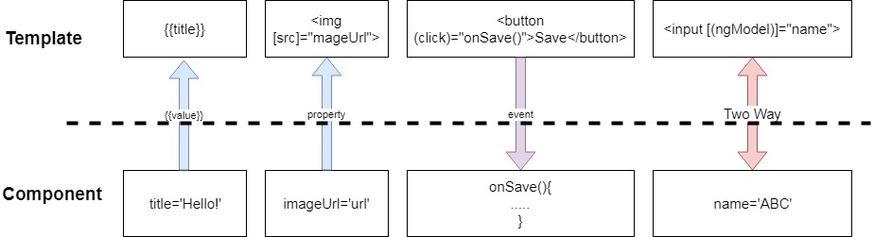
Angular Data Binding
Data Binding Type

Slide 27
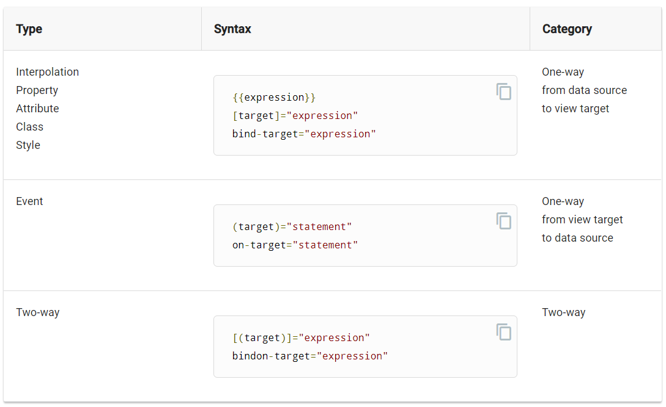
Angular Data Binding

Slide 28
Angular Data Binding
Property Binding
<img [src]="itemImageUrl">
itemImageUrl = '../assets/phone.png';

Slide 29
Angular Data Binding
Attribute, class, and style bindings
<tr><td [attr.colspan]="1 + 1">One-Two</td></tr>
<div class="myClass" [class]="myClassBinding">Setting all classes with binding</div>
<h1 [class.myClass]="isTrue">This class binding is for true value</h1>
<h1 [style.color]="blue">This is a Blue Heading</h1>

Slide 30
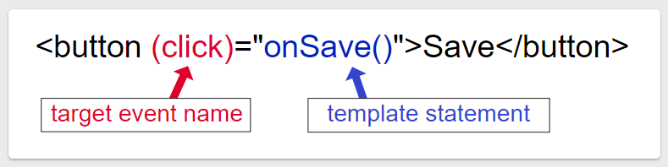
Angular Data Binding
Event Binding
Ref to DOM event object
https://developer.mozilla.org/en-US/docs/Web/Events

Slide 31
Angular Data Binding
Event Binding
User actions such as clicking a link, pushing a button, and entering text raise DOM events.
Binding to these events provides a way to get input from the user.
<button (click)="onClickMe()">Click me!</button>
Get user input from the $event object
template: ` <input (keyup)="onKey($event)"> <p>{{values}}</p>`
When a user presses and releases a key, the keyup event occurs, and Angular provides a corresponding DOM event object in the $event variable which this code passes as a parameter to the component's onKey() method.

Slide 32
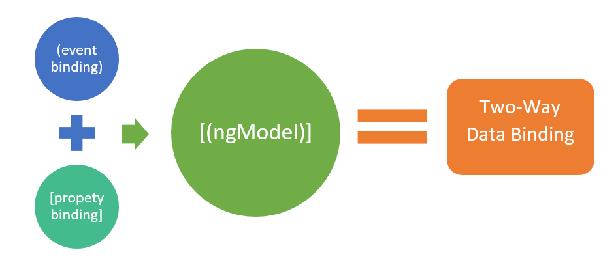
Angular Data Binding
Two-way binding
Two-way binding gives your app a way to share data between a component class and its template.

Slide 33
Angular Data Binding
The NgModel directive allows you to display a data property and update that property when the user makes changes
<input [(ngModel)] ="myMsg"/>
Before using the ngModel directive in a two-way data binding, you must import the FormsModule and add it to the NgModule's imports list

Slide 34
Angular Data Binding
Ref
https://angular.dev/guide/templates/binding
https://angular.dev/guide/templates/property-binding
https://angular.dev/guide/templates/event-binding
https://angular.dev/guide/templates/two-way-binding

Slide 35
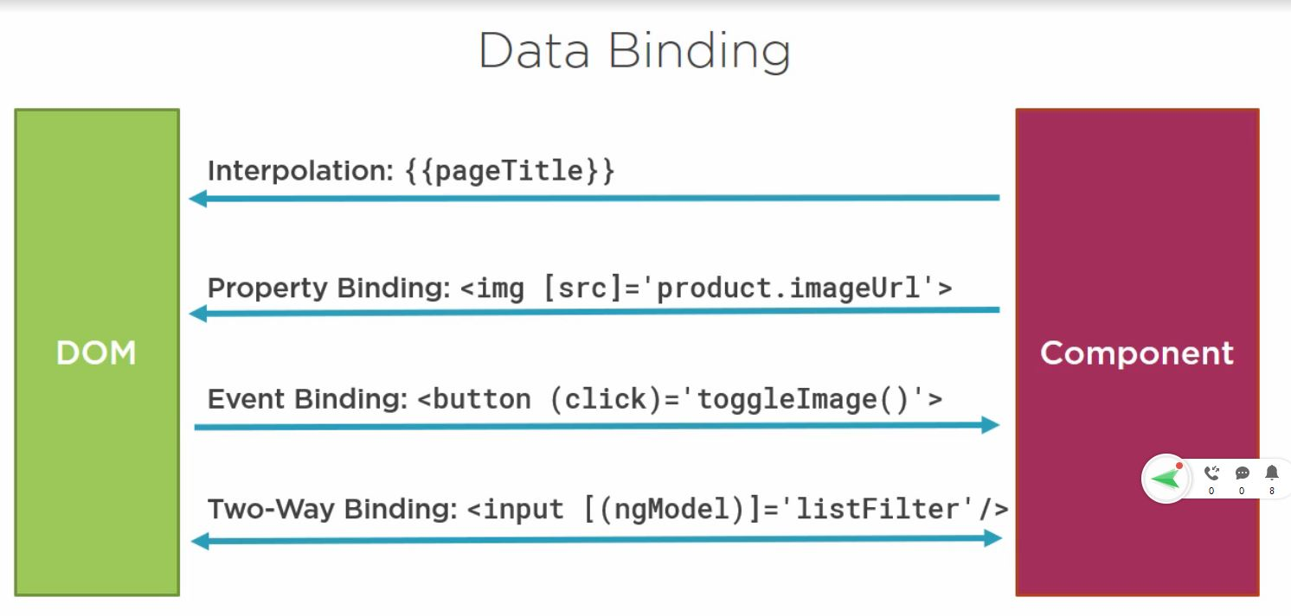
Angular Data Binding

Slide 36
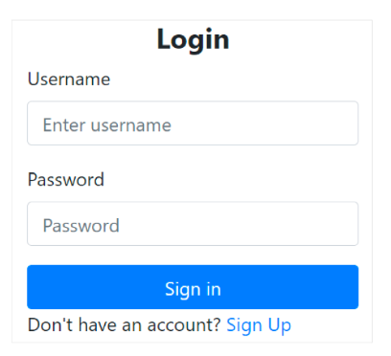
Assignment
[Optional] For anyone who’s not familiar with html/css
Learn some basic about html/css
Setup env and install
Run and look into code structure
https://github.com/helenhash/angular-demo
Investigate Component lifecyle
Create a new Angular Project with basic structure (component, service, model..) (practice and compare between standalone and no-standalone app). Why we should use standalone type?
Create a new component called ‘login’. (standalone)
Focus on create component, binding data and design UI
(using any css framework - boostrap, angular material, tailwind)

